Slide 1
School Psychologist as Counselor
Jon Lasser, PhD
Texas State University
Texas Association of School Psychologists
October 17, 2014
Notes:
CP

Slide 2
Objectives
To present different counseling approaches for use in the school setting.
To provide participants with strategies for integrating counseling in the IEP process.
To outline strategies for treatment and evaluating progress toward counseling goals.

Slide 3
Who Are You?
Do you have a counseling role in your district? Percentage time?
Elementary, Secondary, Multiple?
What is your comfort level with counseling?

Slide 4
Your Presenters
Jon Lasser
(Cindy Plotts)
Texas State University
School Psychology Program
Notes:
CP

Slide 5
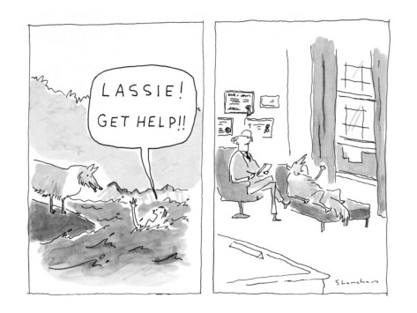
Notes:
CP

Slide 6
Considerations for Counseling in Schools
Constraints
Advantages
Preparation/Competence for Counseling by LSSPs

Slide 7
Constraints
Educational need
ARD input
Measurable outcomes/data-based
Specific time frame
Multiple relationships

Slide 8
Advantages
Naturalistic environment for observation and generalization
Parents not charged
Teacher consultation
Can be supported by parent, teacher, administrator consultation

Slide 9
Preparation/Competence
Graduate training
Experiences in school practice
Theoretical/Empirical Grounding
Limitations/Concerns

Slide 10
Background
Perceived need for a counseling resource designed for the unique role of the school psychologist
Theoretical foundation, but also practical
Conceptually rooted in a link between assessment and intervention
Notes:
CP

Slide 11
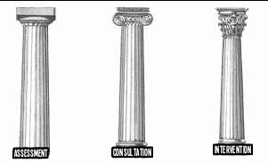
Model for School-Based Counseling
Notes:
JL

Slide 12
Model for School-Based Counseling
Child Oriented
Legal/Procedural
Theoretical
Notes:
JL

Slide 13
Child Oriented
A place of trust and safety in school
Reinforce and support other school missions
Provide resources for self-help, self-direction, and self-regulation
Develop empathy through experiences of active listening and positive regard
Capacity building, bolstering social capital

Slide 14
Why Counseling?
All people communicate. Our goal is to facilitate and “unblock” communication so that it is productive.
All people have problems and strengths and want to be heard and validated.
Active listening (to verbal communication) and tracking (of nonverbal communication) are powerful techniques.
All individuals have a cultural background and history that will affect interpretation of behavior and choice of intervention.
Notes:
CP easing anxiety about counseling

Slide 15
From Child Oriented to Legal/Procedural
Maintain a child oriented focus in spite of the legal and procedural requirements
Comply with IDEA requirements
Follow related service procedures

Slide 16
Developing High-Quality Counseling IEPs
Compliance with IDEIA 2004
First think broadly
Social
Emotional
Behavioral
Then write a broad annual goal
Notes:
JL Compliance includes eligibility for special education, collaboration with IEP team for determining eligibility and developing goals and objectives, time frame, #minutes, group v. individual, etc.
Across districts, wide range of practice will be present, including personnel

Slide 17
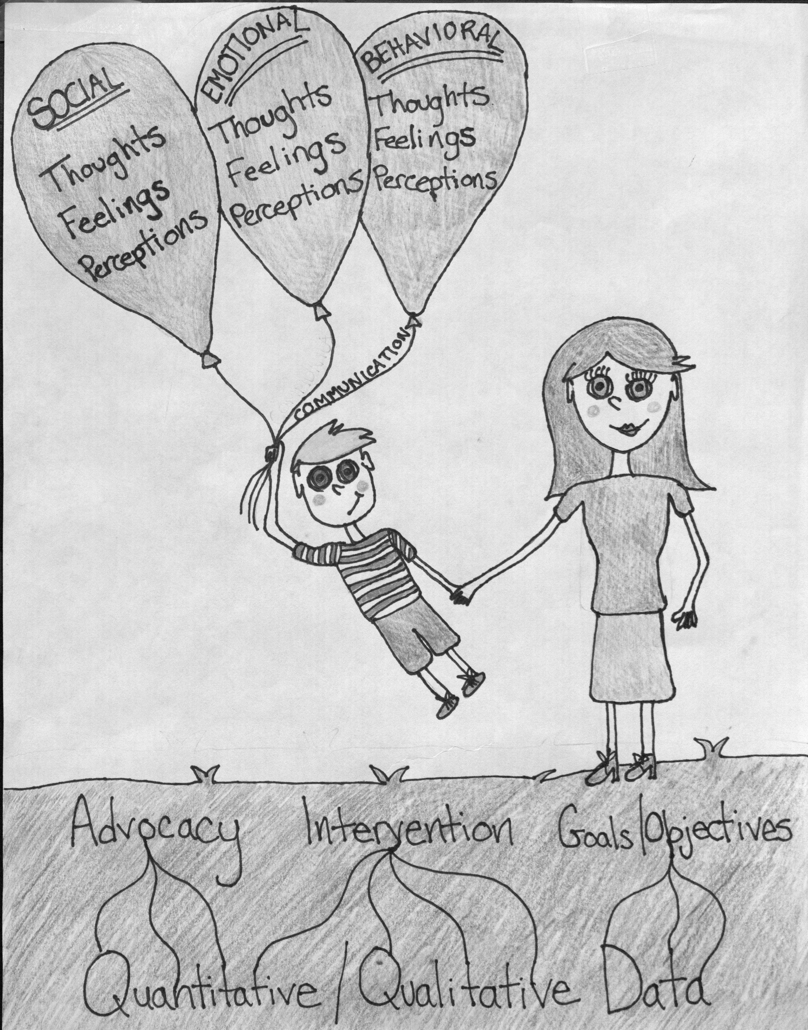
Courtesy Kayla Jones, TX State University
Notes:
CP our student Kayla Jones developed this visual…

Slide 18
Related Service Counseling
See Federal Register, V. 71, No. 156, Monday, August 14, 2006
Related services means…services as are required to assist a child with a disability to benefit from special education and includes… psychological services… counseling services…
Notes:
CP Related service is a broad concept in the law. How school districts conceptualize counseling as a related service will vary.

Slide 19
Related Service Counseling
Related services also include… parent counseling and training.
Counseling services means services provided by qualified social workers, psychologists, guidance counselors, or other qualified personnel.
Notes:
JL Note that the law doesn’t really describe the activities of counseling as a related service, but rather identifies the personnel who provide the service.

Slide 20
Parent Counseling/Training
Assisting parents in understanding the special needs of their child
Providing parents with information about child development
Helping parents to acquire the necessary skills that will allow them to support the implementation of their child’s IEP
Notes:
CP Parent Counseling/Training as a related service may be a productive way of engaging in Family-School Partnering

Slide 21
Psychological Services
Administering… tests and other assessment procedures
Interpreting assessment results
Obtaining, integrating, and interpreting information about child behavior and conditions related to learning
Consulting with other staff members… to meet the special education needs of children as indicated by … evaluations
Notes:
JL School Psychologists providing counseling services may elect to use “Psychological Services” as a related service, or “Counseling” as a related service. We encourage you to consider what’s most appropriate for your district.

Slide 22
More Psychological Services
Planning and managing a program of psychological services, including psychological counseling for children and parents
Assisting in developing positive behavioral intervention strategies
Notes:
JL As you can see, the term “psychological services” as described in the law has many more examples than “counseling”

Slide 23
Context
Instructional Services
Resource, reading program,
specialized instruction, etc.
Various Related Services
OT, Counseling, PT, etc.
Notes:
CP All related services are in support of the broader IEP, meeting the educational needs of the student. This is an important context for understanding how counseling fits in the larger plan.

Slide 24
What is Counseling as a Related Service?
Recall that IDEIA is vague on the subject.
Essentially, it a service (or set of services) provided to address social, emotional, and behavioral functioning in an effort to assist a child to benefit from special education.
Notes:
JL Recall our student’s drawing of the child with the balloons representing the social, emotional, and behavioral domains. This is how we conceptualize counseling as a related service: addressing these domains to assist a child to benefit from special education.

Slide 25
Purpose of Counseling as a Related Service?
Ultimately, the purpose of counseling is dismissal from counseling.
Short term goals and objectives will move us in the direction of dismissal.
Notes:
CP To promote greater independence, problem-solving, and student competency, we say that dismissal from counseling is the ultimate goal. We don’t want to foster dependence.

Slide 26
Overview of Steps
Chapter 7 (The Counseling Process) and Chapter 8 (Working with Teams and Systems)
Referral, assessment, IEP Development, consent, intervention, progress monitoring, dismissal

Slide 27
Guidance For the IEP Team
See handout “Developing Goals for Behavioral, Social, and Emotional Concerns ” for small group activity
Notes:
JL Take a look at the form and consider how this can be used, either as a pre-referral document and/or to plan the counseling IEP

Slide 28
Referral
Referral should ideally be an extension of the RTI process
Are there good Tier I practices in place?
Referral for related services should ask specific questions.
Does X need counseling to be successful in school?
Does X have competencies to make counseling beneficial?
If counseling is indicated, what are the goals? (Note: don’t put the cart before the horse!)

Slide 29
Assessment for Counseling
FIE and RTI
Referral
Archival data
Interviews
Sample Assessment for Review

Slide 30
IDEIA 2004 Requirements
PLAAFP (¡Salud!): Present Levels of Academic Achievement and Functional Performance
Statement of child’s present level of functioning:
How the child’s disability affects the child’s involvement and progress in the general education curriculum
Notes:
JL Special education law requires that the IEP include a present level of functioning.

Slide 31
Present Level of Functioning
Suzie’s frequent anger outbursts and difficulty getting along with peers have a significant negative impact on her academic progress and development of socialization skills. She has a strong desire to please adults and is motivated to improve her social, emotional, and behavioral functioning.
Notes:
CP This example includes information about how the disability impacts the student’s school experience, but also identifies strengths that indicate potential to benefit from counseling.

Slide 32
IDEIA 2004 Requirements
Statement of measurable annual goals designed to:
Meet the child’s needs that result from the child’s disability to enable the child to be involved in and make progress in the general education curriculum and
Meet each of the child’s other educational needs that result from the child’s disability
Notes:
JL Of course, annual goals must be measurable and related to the student’s disability

Slide 33
IDEIA 2004 Requirements
Annual goals must include:
Description of how and when progress will be measured;
A statement of the related service, based on peer-reviewed research to the extent practicable, to be provided to the child, or on behalf of the child, and a statement of the program modification or supports for school personnel that will be provided to enable the child to…
Notes:
CP The counseling IEP must also contain information about progress monitoring. The most recent reauthorization of IDEIA also emphasizes the use of peer-reviewed research

Slide 34
IDEIA 2004 Requirements
to enable the child to…
Advance appropriately toward attaining the annual goals
Be involved in and make progress in the general education curriculum and to participate in extracurricular activities
Be educated and participate with other children with disabilities and nondisabled children in extracurricular activities
Notes:
JL Finally, the goals should be realistic and LRE-centered

Slide 35
Other Details
Projected date for the beginning of the services and modifications
Anticipated frequency, location, and duration
Not in IDEIA, but we recommend a projected end date.
Notes:
CP at the IEP meeting, the team can discuss relevant details related to the counseling service delivery.

Slide 36
Key Pieces of the Counseling IEP
What are the child’s unique needs?
What services will the school employ to address each need?
What will the child be able to accomplish as a result of the services?

Slide 37
An Individualized Approach
There’s no “one size fits all” for counseling
IEP goals are informed by assessment data
There are many ways to make progress on any given goal
Notes:
JL While we use empirically supported intervention, we always keep in mind the individual. Goals precede intervention
Assessment data includes not only FIE, but also assessment for counseling eligibility, which will include baseline data and child characteristics, e.g. developmental level, language capability, degree of insight, openness to counseling relationship, as well as social/emotional/behavioral status. If FBA in place, very helpful.

Slide 38
Measurable Annual Goals for Scott
Scott will make measurable progress in the area of social functioning.
And/Or
Scott will make measurable progress in the area of emotional functioning.
And/Or
Scott will make measurable progress in the area of behavioral functioning.
Notes:
CP Here’s an example of broadly written annual goals for a sample student.

Slide 39
IEP Goals and Objectives
Start with one or more of the broad annual goals.
Write individualize objectives that move the student’s functioning in the direction of the goals.
Include mastery criteria.
Be specific.
Notes:
JL From the broad annual goals come more specific, individualized objectives that move the student toward goal completion. At the objective level we include mastery criteria.

Slide 40
Example
Annual Goal: Alex will make measurable progress in the area of social functioning.
Objectives: Alex will demonstrate improved peer interactions in the classroom (3/5 peer interactions positive)
Evaluated by counselor/teacher observation, individualized rating form, self-report
Notes:
CP This example includes the goal, objective, and methods of evaluation.

Slide 41
Bank of Goals and Objectives
There’s nothing wrong with developing a district bank of goals and objectives
Must be sure to individualize for each student
Mastery criteria ought to be established from baseline data
Notes:
JL pros and cons of using a bank of goals

Slide 42
Progress Monitoring
Data collected collaboratively by LSSP and teacher measuring the specific objectives in the IEP
Reported as an IEP progress report every 9 weeks
Mastery criteria adjusted as data indicate what’s working and what isn’t
Data also informs consultation efforts

Slide 43
Dismissal
Data-based decision
ARD committee decision
Ultimately the goal
Supported

Slide 44
Definition of a Problem
A problem is a gap between what someone is doing and what is expected.
Jerome complies with 1/5 requests.
Teacher would like Jerome to comply with 5/5 requests.
Do we need to meet in the middle?
Notes:
CP Mastery criteria should be individualized for each student with input from members of the IEP team.

Slide 45
Determining Appropriateness of the Intervention
The ARD committee should consider a number of factors before adding counseling as a related service.
A structured format (provided) can facilitate the process of making these decisions
Consider a tiered approach.

Slide 46
Progress Monitoring
We’re required to monitor and report on counseling progress.
Emphasis should be placed on data
Several tools can be used:
Counselor-made measures
PNRTs
Criterion-referenced measures
Notes:
JL Progress monitoring is critical, and we have lots of ways to do this, each with their own advantages and disadvantages.

Slide 47
Counselor-Made Measures
Can be individualized to match IEP goals and objectives
Completed by teachers, parents, students, etc.
Can be informed by other sources of data (e.g., observations, behavior frequency counts, etc.)
Notes:
JL We have provided a sample in your handouts of a counselor made measure. Benefits listed on slide. Good face validity, but not psychometrically strong.

Slide 48
PNRTs
Provide a normative basis
Typically not sensitive to small changes, although exceptions exist (some adaptive behavior scales)
May have better reliability
Notes:
CP PNRT=Published Norm Referenced Tests (e.g., BASC)

Slide 49
Criterion-Referenced Measures
What if a school developed criteria for social, behavioral, and emotional success?
Skills and sub-skills enumerated
Clear criteria and cut scores
Could be used as an indicator of counseling progress
Notes:
JL SEL in general ed curriculum uses some specific criteria in some districts

Slide 50
Always link progress to IEP
Regardless of the method(s) used, progress should always be framed in terms of the IEP goals and objectives.
Progress reporting should be data driven as well as narrative.
Notes:
CP Progress must always be in terms of the IEP goals

Slide 51
Goal/Objective Goal: Alex will make measurable progress in the area of behavioral functioning. Objective: Demonstrate productive behavior in academic situations by increasing task completion (90%).
Example of Progress Report
Progress report: Alex was seen for six counseling sessions this reporting period. Consultation with teachers and his mother played an instrumental role in monitoring and modifying his behavior. He has demonstrated greatly improved coping strategies and significant gains in assignment completion (85%).
Notes:
JL an example

Slide 52
Negotiating the Details
Direct vs. Indirect
Importance of Consultation
Parent Training/Counseling
Individual vs. Group
Frequency, duration, etc.
Documentation
Notes:
CP The IEP team can also discuss a number of other details/options

Slide 53
Considering Individual vs. Group Intervention
Severity of emotional/behavioral interference
Interpersonal relating/capacity to listen & share
Ability to adhere to group ground rules
Specific situational issues (e.g., divorce, grief) that lend themselves to group intervention.
Notes:
CP After IEP goals are established, the service provider can consider individual vs. group intervention

Slide 54
Counseling Activities: Questions to Guide Choices
What is the child’s developmental level, especially verbally and cognitively?
What is the trust level?
Is there a specific presenting problem?
Are supportive resources (parents, teachers) available to implement strategies?
Is immediate change necessary for the child’s safety or well-being?
Notes:
JL When discussing treatment modalities and activities, consider these questions.

Slide 55
Low Cognitive/Verbal Level Students
Behavioral Techniques to foster consistent environmental structure, behavioral expectations, and consequences (consider consultation)
Behavior contracts/charts to document and reinforce progress. Tangible rewards effective.
Low verbal demand art/play activities to build sense of safety and alternatives to verbal communication
Focus on relationship: reliability, acceptance, respect and fun
Notes:
CP recommendations for low cognitive/verbal students

Slide 56
High Cognitive/Verbal Student
Cognitive-Behavior Techniques
Reality Therapy
Rational-Emotive Behavior Therapy
Group Interventions
Solution oriented, motivational interviewing
Notes:
JL Students who have good executive funcitons and ability to talk about them, i.e., self-monitoring, planning ahead, considering past choices and their outcomes, naming feelings

Slide 57
High Cognitive/Low Verbal
Activities with low verbal demand, minimal performance expectations, symbolic representation, e.g., sandtray, art activities
Social modeling
Psychoeducational approaches
Bibliotherapy
Notes:
CP Unable/unwilling to verbalize thoughts and feelings, possibly highly anxious about counseling

Slide 58
Techniques
Problems are addressed with interventions.
Interventions are selected based on client and counselor variables.

Slide 59
Nondirective Approaches
Unconditional positive regard
Nondirective play therapy (warmth, genuineness, tracking, reflection, tolerance of low structure, theme and metaphor recognition)
Person-Centered counseling (congruence of ideal and real selves, relationship of primary importance

Slide 60
Semistructured Play/Activity Techniques (often Gestalt)
Art activities with prompts (KFD, Collage, Timeline, Scribble Art)
Clay activities (e.g., something about you)
Bibliotherapy
Mutual Storytelling
Therapeutic use of games
Sandtray

Slide 61
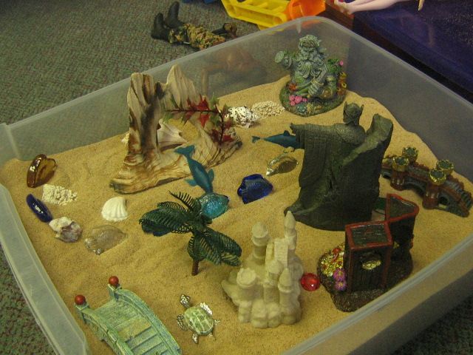
Sandtray (Your World)

Slide 62
Structured Techniques
Reality Therapy (problem & solution oriented, verbal skills, ability to recall, think ahead & recognize options, practice & feedback)
Cognitive-Behavioral Techniques (recognition and expression of thoughts and feelings, developing self-monitoring and self-talk, use of environmental contingencies)
Positive Psychology
Behavioral Approaches (clear problem identification, collecting of baseline data, collaborating with other caretakers, environmental engineering, contracting)
Special Applications: Anxiety reduction (systematic desensitization), Relaxation training (progressive relaxation, imagery), Mindfulness

Slide 63
Cognitive Therapy

Slide 64
Basic Principles
Client is understood in terms of his/her current thinking and its impact on feelings and behaviors
What’s the relationship between thoughts, feelings, and behaviors?

Slide 65
Basic Principles
The foundation is a strong therapeutic alliance
warmth, caring, empathy, trust

Slide 66
Basic Principles
The technique requires collaboration and active participation.
Teamwork, partnership, working together. Gradual transition to increasingly active client.

Slide 67
Basic Principles
Goal oriented and problem focused.
What are your problems, goals, and obstacles?

Slide 68
Basic Principles
Initial emphasis is on the present.
Here and now. Therapist examines past experiences selectively when indicated.

Slide 69
Basic Principles
CBT is educative.
Teach the client to be his/her own therapist, teach the method, prevent relapse.

Slide 70
Basic Principles
It’s a time-limited therapy.
4-14 sessions to provide symptom relief and avoid relapse.

Slide 71
Basic Principles
Structured sessions.
Mood check
Brief review of the week
Collaboratively set agenda
Feedback from previous session/HW review
Discuss agenda items
Assign homework
Summarize/feedback

Slide 72
Basic Principles
Teach clients to identify, evaluate, and respond to their dysfunctional thoughts and beliefs.
Socratic questioning & Collaborative empiricism
Have you ever had this happen to you before?
What did you do that time?
What advice would you give to a friend in this situation?
(Padesky, 1993)

Slide 73
Cognitive Conceptualization
Situation leads to
Automatic Thought (from core belief)
Leads to Emotion
and Behavior

Slide 74
Cognitive Conceptualization
Thinking about tomorrow’s math test leads to automatic thought:
“I won’t make it through the course”
(derived from core belief: I’m inadequate)
Leads to feeling sad and little to no effort studying

Slide 75
thinking errors
All or nothing
“If I’m not a total success, I’m a failure”
Catastrophizing
“I’ll be so upset, I won’t be able to function at all”
Discounting the positive
“I did that project well, but only because I got lucky”

Slide 76
thinking errors
Emotional reasoning
Ignore the evidence and focus on feelings
“I know I do things ok, but I feel like a failure”
Labeling
“I’m a looser”
Magnify/Minimize
“Getting good grades doesn’t mean I’m smart”
“My adequate evaluation means I’m no good”

Slide 77
thinking errors
Mental filter
“That one low score on my job evaluation means I’m no good”
Mind reading
“He thinks I don’t do anything right”
Overgeneralization
“I felt awkward at the dance, so I don’t have what it takes to make friends”

Slide 78
thinking errors
Personalization
“The waiter was curt to me because I did something wrong”
Imperatives
“I shouldn’t make mistakes” or “I must always be successful”
Tunnel Vision
“The other kids are mean and insensitive (failure to see any positives)

Slide 79
Situation | AT and % belief | Emotion | Adaptive response | Outcome
Studying for exam | I’ll never learn this. I’m stupid 80% | Anxious Sad | What’s the evidence that the AT is true? Is there another explanation? What’s the worst that could happen? What’s the effect of believing the AT? | New belief % in AT. New emotion or change in intensity. What will you do?

Slide 80
Choice Theory & Reality Therapy: William Glasser
He was a board-certified psychiatrist
Famous (or infamous) for never prescribing meds for clients
Creator of Choice Theory and Reality Therapy
Started teaching it in 1965
Passed away August, 2013

Slide 81
Choice Theory
A psychological theory for understanding human behavior
Is the over-arching theory within which reality therapy resides
Formally called Control Theory (some problems with that)
Central tenants include:
That all we do is behave
Almost all behavior is chosen (internally controlled & motivated)
All behavior that we chose is to satisfy 5 basic, genetically-programmed needs
Survival (the physiological need)
Love & belonging
Power
Freedom
Fun
Locus of control is central to choice theory

Slide 82
5 Basic Needs
Survival (the only physiological need): food, water, shelter, sleep, elimination, sexuality
Four psychological needs are:
Love & Belonging: be with & relate to others; share, join, & have relationships with others
Power: gain importance, recognition, & achieve competence
Freedom: move, choose, act, & think without restriction
Fun: learn, laugh, play, experience pleasure
The need that is satisfied least drives our behavior the most

Slide 83
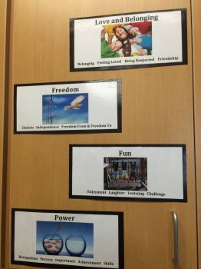

Slide 84
Can you think of a need that doesn’t fit into one of these categories?

Slide 85
Love & Belongingness as the Most Important Need
It is the most important need bc we need people to satisfy the other needs
Based on choice theory, clients are choosing their behavior in an attempt to deal with the frustration caused by unsatisfying relationships
The therapeutic relationship is so critical bc when a client comes to you, it is most likely that they are in distress because the belongingness/love need is not being satisfied

Slide 86
The Quality World
Shortly after birth throughout the rest of our lives, we begin storing information about what feels very good to us
They become specific pictures in our heads of the things that meet our basic needs
This is our personal Shangri-la & it is the world that we would live in if we could

Slide 87
Take Inventory of Your Quality World

Slide 88
Mental Illness According to Dr. Glasser
Mental illness, for the most part, represents a choice (sometimes a very creative choice) to deal with the frustrated needs that are in our quality world
Very few mental illnesses can be attributed to brain anomalies (Alzheimers)
Prove it!

Slide 89
Total Behavior
All behavior is made up of 4 inseparable but distinct components:
Acting
Thinking
Feeling
Physiology
Focus of RT is acting & thinking bc we can control those
Main difference between CBT & RT: It is easier to act your way into a different way of thinking than to think your way into a different way of acting
Depressed vs. Depressing

Slide 90
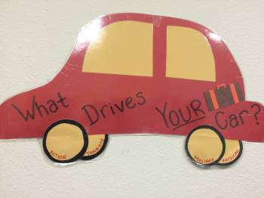

Slide 91
Role of Feelings
Feelings are like a barometer of how well we are satisfying our needs within our quality world
When we feel, sad, angry, frustrated, etc., the root will be a need within our quality world that is being unmet
Most likely, the client is not satisfied with one or more interpersonal relationships

Slide 92
Reality Therapy
A counseling technique established by Dr. Glasser to help us choose more effective behavior.
Goal is to help counselees take ownership of their behavior & responsibility for directions in their lives

Slide 93
The Therapist’s Relationship with Clients
Try to get into the client’s quality world
Through the relationship with the therapist, the client learns how to get close to the people they need
Need to establish a trusting relationship so that you can teach the client choice theory
Want the client to replace external control psychology (which is a source of much frustration) with choice theory

Slide 94
Characteristics of an Effective Reality Therapist
Be involved in good relationships yourself
Able to interact with a wide variety of people comfortably
Be open & accepting
Have your finger on the pulse of popular culture
Have a large repertoire of successful life experiences
Most important characteristic: be in better shape than the client (particularly in areas that the client is not effective)

Slide 95
Primary Components of R.T.
The counseling environment
Build a close relationship built on TRUST & HOPE through friendliness, firmness, & fairness
Need to develop a strong, therapeutic relationship that includes empathy
Discuss problems in the past tense, solutions in the present & future tenses
Don’t argue, boss, manage, blame, criticize, encourage excuses, demean, instill fear
Stress what they CAN control, accept them as they are, & keep confidence that they will develop more effective behaviors
The procedures that lead to change
Use the WDEP system

Slide 96
The WDEP System
Wants – What do you want? What do you want to have happen? How do you want this to turn out?
Doing – What are you doing? (Actions, thinking, feeling). Don’t ask why…ask what
Evaluation – Is it helping you? Is it working for you? Is it getting you want you want? Is it effective?
Plan – What’s your plan? What are you going to do?

Slide 97
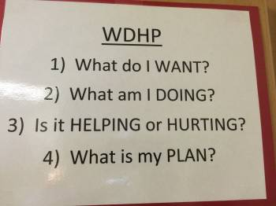

Slide 98
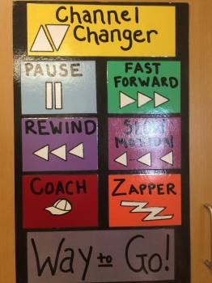

Slide 99
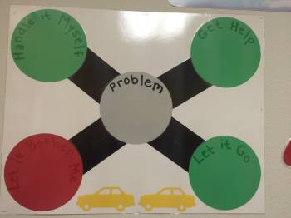

Slide 100
Empirically-Validated Interventions
Research readings and reviews should supplement techniques books (like Oaklander)
Always look at the samples and controlled variables in studies: how generalizable are the results? Can I replicate the conditions in the study? Are my clients similar to those in the study?
With meta-analyses, consider that data collapsed across studies may mask individual differences and responsiveness; case studies are also valuable

Slide 101
Specific Interventions Theory/Techniques/Empirical Support
Depression: CBT, IPT, ACTION (Stark), CWDA (ages 12-18)
Coping With Depression-Adolescents Manual and Workbook
Anxiety: Coping CAT (ages 7-13 plus adolescent version)
(Kendall, Furr, Podell, 2010)
Impulsivity
Aggression: Anger management program from SAMHSA, multisystemic approaches most effective
CASEL
SAMHSA

Slide 102
Eclectic Counseling Model
Person-Centered
Active Listening
Empathy
Unconditional Positive Regard
Play, Sand Tray, Open-Ended
Art Therapy, KFD, Fingerpaint, Scribble Art
Gestalt Therapy, Fantasy/Relaxation, Empty Chair, Top Dog/Underdog
Cognitive, CBT, Reality Therapy, Rational-Emotive

Slide 103
Group Counseling
Advance preparation (needs assessment, group promotion and member selection, # sessions, activities/curriculum, evaluation)
Leadership skills (ground rules, ice breakers, go rounds, linking, drawing out, cutting off) and getting coleader if possible
Multicultural considerations (ethnicity, homogeneous/heterogeneous, self-disclosure, social behaviors, etc.)
UNIVERSALITY & SAFETY

Slide 104
Crisis Intervention: KNOW YOUR SCHOOL DISTRICT AND CAMPUS PLAN
Many types of crises, both individual and group
Willingness to help, be involved, plan
Collection of readily available materials for suicide assessment, postvention, connection to resources in community, documentation of contacts
Considerations of privacy vs. safety

Slide 105
Crisis Counseling
People react differently to crises: meet them where they are
Respect cultural differences in involving outsiders, grieving process, rituals
Consider developmental levels in understanding of death and loss
Recognize that teachers/staff grieve too
Be prepared to follow up at a later date

Slide 106
Family Considerations
Take advantage of the opportunities we have to involve families: interviews, ARDS
Recognize that all behavior occurs in the context of dynamic and interdependent systems
Use active listening and group management techniques to facilitate effective family-school collaboration

Slide 107
Multicultural Considerations
Metatheory—no theory right or wrong
Individual, group, and cultural contexts must all be considered
Cultural identity development integral
Counseling is only one of the helping roles
Self-study, consultation and supervision essential for competent multicultural practice
Systemic framework, solution-oriented, ideographic approaches recommended

Slide 108
Transition
Related Services to General Education Counseling
Concluding Counseling/Generalization

Slide 109
Resources
The California Evidence-Based Clearinghouse for Child Welfare
www.cebc4cw.org

Slide 110
Counseling with Drug-Abusing Youth* *adapted from NASP webinar presented by Ken Winters, Ph.D. on Nov. 6, 2013
Basic Principles
Develop a strong yet caring relationship
Help him or her to break the functional value of the drug use
Abstinence is ideal but may need behavioral shaping towards that goal
Harmful consequences exist on a continuum
(harm reduction, risk reduction)

Slide 111
Counseling for Substance Abuse
Techniques
Brief Intervention (up to 8 sessions; 2-4 typical)
Motivational Interviewing (person-centered, not confrontational)
Most effective with use/abuse rather than addiction

Slide 112
Motivational Interviewing
EE—Express Empathy
AA—Avoid Arguing
RR—Roll with Resistance (reframe)
SS—Support Self-Efficacy
DD—Develop Discrepancy (present and future)

Slide 113
Decisional Balance (Pro-Con Exercise)
What are the pros of the adolescent’s drug use?
What are the cons (negatives) of the adolescent’s drug use?

Slide 114
Evidence-Based Approaches
SAMHSA National Registry of Evidence Based Programs and Practices

Slide 115
Case Examples
“Jake”
Jake is a 4th grade student who transferred in from another state. Although his records were incomplete, documentation clearly indicated that he had been receiving special education services for speech only.

Slide 116
Initial Concerns
His ARD committee meets and decides to start Jake with his speech-only services, but after his first day of classes, his teacher contacts the school psychologist with the following concerns:
-Jake did not interact with any of his classmates
-He refused to leave the classroom when it was time to go to specials
-He rarely participated, but when he did, he responses were odd, off-topic, and frequently involved the topic of sharks.

Slide 117
Request for more data
-Clinical interview with parents and Jake
-Cognitive measures
-Achievement measures
-Social/emotional measures
-Observations across settings
-Behavior rating scales (broad spectrum
-Adaptive behavior assessment
-Autism rating scales

Slide 118
Behavioral Observations
Initially, Jake was compliant when the school psychologist began the assessment. He answered questions in such a way that demonstrated good receptive language skills, but he occasionally refused to respond to some inquiries. The examiner noted some unusual prosody (Jake spoke with a “sing-songy” voice) and Jake’s persistent way of steering the conversation on to the topic of sharks.
The cognitive assessment was initially successful, but later became difficult. The first few subtests indicated very strong cognitive abilities, and Jake appeared to be comfortable with the testing. However, he became very frustrated with some of the teaching items, perhaps because he found them to be unnecessary. At this point, he refused to participate and was sent back to class. Two more attempts were made to complete the cognitive assessment, but he refused both times. Similarly, Jake refused the achievement tests.

Slide 119
Results
Behavior rating scales and adaptive behavior scales were completed by Jake’s parents and teachers and indicated deficits in social and communication skills, some atypicality, and externalizing behaviors. The autism rating scales suggested the possibility of an autism spectrum disorder.
Utilizing multiple sources of data, the school psychologist, in collaboration with the multidisciplinary team, determined that Jake met the criteria for an autism spectrum disorder.

Slide 120
Eligible for Counseling
A counseling eligibility report was developed, utilizing the data from the FIE as its primary source. Additional data were gathered to inform the goal and objective development, including some baselines for behaviors of concern. Additionally, Jake’s counseling competencies were identified (e.g., motivation to change, capacity to work with a caring adult, etc.).
The school psychologist drafted IEP goals and objectives and shared them with Jake’s parents and teachers 5 days before the ARD. At the ARD, the goals and objectives were slightly modified and finalized

Slide 121
Goals and Objectives
Jake will make measurable progress in the area of social functioning, as evidenced by:
-Jake initiating social interaction with peers with teacher prompting (at least twice per day with one prompt per interaction).
-Jake making appropriate (on-topic) contributions to peer conversations (50% of his contributions on-topic).
Jake will make measurable progress in the area of behavioral functioning, as evidenced by:
-Compliance with teacher request to transition to specials (3/4 times compliant).

Slide 122
Intervention
The ARD committee recommended 60 minutes/week of counseling (30 minutes individual and 30 minutes group), as well as consultation with parents and teachers.
The following interventions were put in place:
1. Parent-teacher CBC facilitated by LSSP to develop some consistency across settings.
2. Individual counseling with a social skills training focus to rehearse and practice appropriate social conversations.
3. Group sessions with typically developing, non-referred students as well as other students on the spectrum to increase generalization and promote interaction.

Slide 123
Case Study: “Jenna”
See Handout
Discuss

Slide 124
Thank You!
We look forward to continued discussion!

